Slide 1

Design of system to generate photo realistic face images from textual description using GAN
BE-COMP-A
A17
Vikas Kushwaha (55)
Nikita Mahajan (56)
Rajeshwari Mishra (62)
Guide: Mrs. Shiwani Gupta

Slide 2
Index
Problem definition
Category of the project
Type of the project (in-house/out-house)
Real world application of project
Domain
Literature Survey & Gap/s Identified
Structural model(Block diagram/DFD/ER Diagram)
Flowchart/Algorithm
Tools and technologies
Conclusion
References

Slide 3
Problem Definition
Synthesizing high-quality images from text descriptions is a challenging problem in computer vision and has many practical applications. Samples generated by existing text-to-image approaches can roughly reflect the meaning of the given descriptions, but they fail to contain necessary details and vivid object parts. We are motivated by the potential of automated face generation to impact and assist critical tasks such as criminal face reconstruction.

Slide 4
Project details
Domain: Intelligent System Design and Development.
Category: Application based.
Type of project: Inhouse.
Application: Useful for Crime cases, engineers, scientist, designers. Designed for government and industry usage

Slide 5
Literature Survey
Title of the paper | Journal and year of publication | Summary of the paper | Gap identified
Text2FaceGAN: Face Generation from Fine Grained Textual Descriptions | 2019 IEEE Fifth International Conference on Multimedia Big Data (BigMM) | In this work they presented captions for the CelebA dataset to facilitate face synthesis from text. Then they used Generative Adversarial Network to learn the conditional multimodality in synthesis of face from captions | Improve the selection of the wrong image for the GAN-CLS algorithm. Currently, they randomly select images from the dataset as the wrong image .Explore better language models such as BERT, analyze and compare performance of other GAN architectures with their model for face generation from captions
AttnGAN: Fine-Grained Text to Image Generation with Attentional Generative Adversarial Networks | 2018 IEEE/CVF Conference on Computer Vision and Pattern Recognition | Attentional Generative Adversarial Network is proposed for fine-grained text-to-image synthesis which gives effective results for complex scenes. | To work on global coherent structure to eliminate the failure which could not be resolved by the current method.

Slide 6
StackGAN: Text to Photo-realistic Image Synthesis with Stacked Generative Adversarial Networks | 2017 IEEE International Conference on Computer Vision | It proposed the Stacked Generative Adversarial Networks (StackGAN) to generate 256×256 photo realistic images conditioned on text description & the outcome generated has higher resolution as compared to text-to-image generative models. | To improve the diversity of synthesized images and to stabilize the training of Conditional GAN introduced Conditioning Augmentation Technique.
A style-based generator architecture for generative adversarial networks | 2019 IEEE Conference on Computer Vision and Pattern Recognition | They proposed an alternative generator architecture for generative adversarial networks, borrowing from style transfer literature. The new architecture leads to an automatically learned, unsupervised separation of high-level attributes and stochastic variation in the generated images and it enables intuitive, scale-specific control of the synthesis. | We should also focus on text irrelevant contents in the original image.

Slide 7
Photographic Text-to-Image Synthesis with a Hierarchically-nested Adversarial Network | 2018 IEEE/CVF Conference on Computer Vision and Pattern Recognition | This paper presents a novel method to deal with the challenging task of generating photographic images conditioned on semantic image descriptions. The method introduces accompanying hierarchical-nested adversarial objectives inside the network hierarchies, which regularize mid-level representations and assist generator training to capture the complex image statistics. | Focus on increasing the visual quality and resolution of generated images.

Slide 8
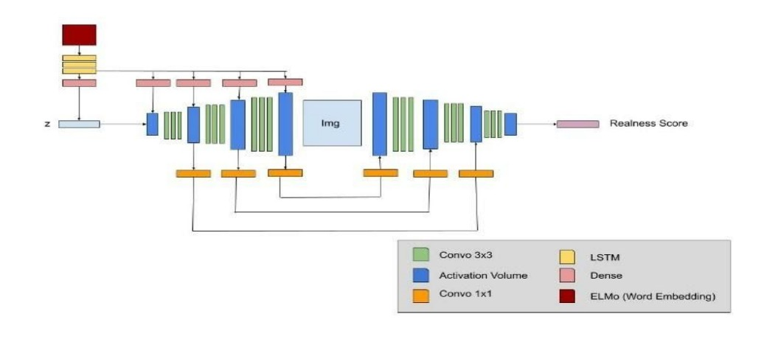
Neural network model

Slide 9
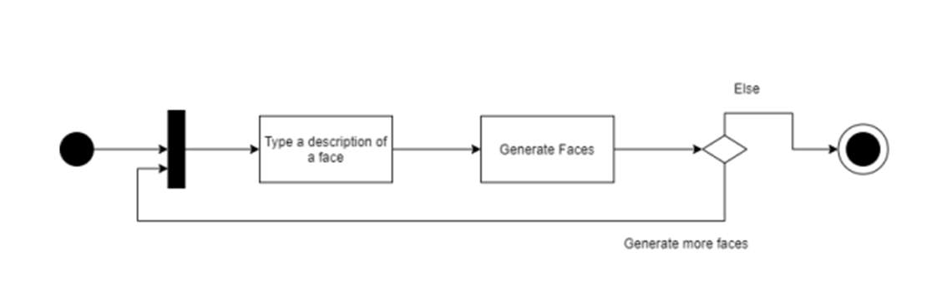
Activity Diagram

Slide 10
Methodologies to be used
GAN(Generative Adversarial Network).
DCGAN(Deep Convolutional Generative Adversarial Network).
PROGAN(Progressively Growing GAN).
WGAN(Wasserstein GAN).
TRANSFER LEARNING.
StackGAN.

Slide 11
Tools
Tools:
Python3 libraries
A faster GPU and TPU
Technologies:
Jupyter Notebook
Google Colab

Slide 12
Pseudocode
Input: minibatch images, maching text, number of training batch steps ‘S’
Step 1: for n=1 to S do
Step 2: Encode matching text description
Step 3: Draw sample random noise
Step 4: Forward through Generator
Step 5: real image and real text classified by discriminator
Step 6: fake image and real text classified by discriminator
Step 7: Update Generator
Step 8: Update Discriminator
Step 9: End for

Slide 13
Performance Analysis
The Frechet Inception Score(FID) score is used for evaluating the quality of images generated by GANs by calculating the distance between the feature vectors for real and generated images. The FID scores are inversely related to the quality of images i.e. lower the score, higher the quality of images.
The Inception Score, or IS for short, is an objective metric for evaluating the quality of generated images, specifically synthetic images output by generative adversarial network models.
The score seeks to capture two properties of a collection of generated images:
Image Quality. Do images look like a specific object?
Image Diversity. Is a wide range of objects generated?

Slide 14
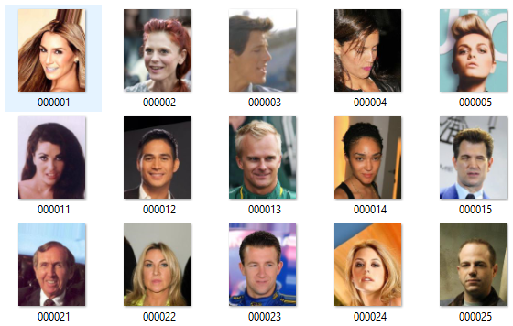
Datasets
A popular component of computer vision and deep learning revolves around identifying faces for various applications from logging into your phone with your face or searching through surveillance images for a particular suspect. This dataset is great for training and testing models for face detection, particularly for recognising facial attributes such as finding people with brown hair, are smiling, or wearing glasses. Images cover large pose variations, background clutter, diverse people, supported by a large quantity of images and rich annotations.

Slide 15
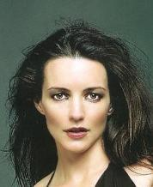
Descriptions of images
The dataset is provided in json format structured as a list of objects consisiting of the following:
1. response_id: A unique ID referring to a unique annotator/image pair.
2.filename: The filename of the image in the CelebA dataset.
3.user_id: A unique ID referring to the annotator that wrote the description.
4.description: The description written.
Here is an example:
[
{
"response_id": "4683",
"filename": "000035.jpg",
"user_id": "2",
"description": "A woman with a chiselled jaw, prominent cheekbones, a long, narrow nose and thin eyebrows. She has long, messy, black hair and she is wearing makeup."
},
...
]

Slide 16
WORK DONE
We have collected the description of about more than 4k images randomly selected from celebA(Dataset) and then filtered out images from celebA(Dataset) which contains 200k images to a new dataset which contains 4-5k images.
Since, our dataset is very less and we are lacking resources(GPU) we are going to use a TRANSFER LEARNING technique to train our model.
We have finalized the various models to used in Stack manner at various levels of neural network.
Some of the problems with GAN models are problem with counting, perspective, global structure.

Slide 17
Conclusion
We can assert that Text to Face Generation is a viable project with some very interesting applications. For instance, Text to face can help in identifying certain perpetrators / victims for the law agency from their description. It can also be use in applications where people can write their face description and can get their face generated. The application can be used by both government as well as industry.

Slide 18
References
[1] Osaid Rehman Nasir, Shailesh Kumar Jha, Manraj Singh Grover, Yi Yu†, Ajit Kumar and Rajiv Ratn Shah, “Text2FaceGAN: Face Generation from Fine Grained Textual Descriptions” 2019 IEEE Fifth International Conference on Multimedia Big Data (BigMM).
[2] Han Zhang, Tao Xu, Hongsheng Li, Shaoting Zhang, Xiaogang Wang, Xiaolei Huang, Dimitris Metaxas in “StackGAN: Text to Photo-realistic Image Synthesis with Stacked Generative Adversarial Networks” 2017 IEEE International Conference on Computer Vision, pp. 5907–5915.
[3] Tao Xu, Pengchuan Zhang, Qiuyuan Huang, Han Zhang, Zhe Gan, Xiaolei Huang, Xiaodong He, “AttnGAN: Fine-Grained Text to Image Generation with Attentional Generative Adversarial Networks” 2018 IEEE/CVF Conference on Computer Vision and Pattern Recognition.
[4] Zizhao Zhang, Yuanpu Xie, and Lin Yang, “Photographic text-to-image synthesis with a hierarchically-nested adversarial network,” in Proceedings of the IEEE Conference on Computer Vision and Pattern Recognition, 2018, pp. 6199– 6208.
[5] Tero Karras, Samuli Laine, and Timo Aila, “A style-based generator architecture for generative adversarial networks,” in Proceedings of the IEEE Conference on Computer Vision and Pattern Recognition, 2019, pp. 4401–4410.
[6] Guojun Yin, Bin Liu , Lu Sheng, Nenghai Yu , Xiaogang Wang , Jing Shao, “Semantics Disentangling for Text-to-Image Generation” arXiv:1904.01480v1 [cs.CV] 2 Apr 2019.
[7] Micah Hodosh, Peter Young, and Julia Hockenmaier, “Framing image description as a ranking task: Data, models and evaluation metrics,” Journal of Artificial Intelligence Research, vol. 47, pp. 853–899, 2013.
[8] Zizhao Zhang, Yuanpu Xie, and Lin Yang, “Photographic text-to-image synthesis with a hierarchically-nested adversarial network,” in Proceedings of the IEEE Conference on Computer Vision and Pattern Recognition, 2018, pp. 6199– 6208.

Slide 19
Thank you !!

